Slide 1
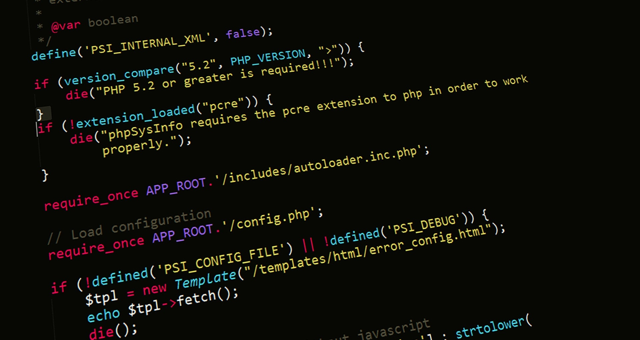
Server-Side Web Programming (COMP10260)
WEB architecture – Part I

Slide 2
GET and POST Requests

Slide 3
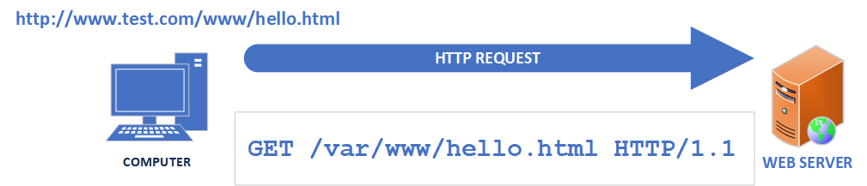
STATIC HTML - Requests
The oldest kind of web application is a static HTML page. It effectively treats the web server like a file server
The user requests a file by typing a URL into a web browser. The first part of the address www.test.com tells the browser where to send the request. The part after the first slash is where in the server's directory the file is located – also known as a path (or pathname).
As we saw in lecture 1, the browser requests the file by sending the word GET, the pathname and the version of HTTP protocol we are using (in this case 1.1) to the webserver in plain text.

Slide 4
HTTP Request
GET /var/www/hello.html HTTP/1.1
User-Agent: Mozilla/4.0 (compatible; MSIE5.01; Windows NT)
Host: www.test.com
Accept-Language: en-us
Accept-Encoding: gzip, deflate
Connection: Keep-Alive
(there are two <CR><LF> sequences here)
Data entered by the USER
HTTP Request Method
Information supplied by the Browser

Slide 5

Anatomy of a HTTP Request
HTTP Request Method
As we have mentioned this type of request is called a GET and it is intended for requesting data from a server. When we talk about “GET” refer to is as the “Request Method” (or sometimes the “verb”) of this HTTP Request
There are several other types of HTTP Request methods which are used. The most common are GET, and POST followed by PUT and DELETE.
It is important to understand that while most web servers will retrieve a document when passed a GET request. There is nothing that actually requires the server to behave in this way. You could write a web application so that when it receives a GET Request like: http://www.baseball.com/BlueJays/update/score
It updates a database of baseball statistics instead of sending you a document. This is sometimes called an “Overloaded GET” and we will talk more about this when we start talking about REST API’s

Slide 6
HTTP Request Methods (Verbs)
Method/Verb | Result
GET | Retrieve information from the specified path on the webserver. The only information the user can send is in the URL. A GET can be cached (and so it shows up as part of your browser history). It displays any data sent with it on the URL line (not good for sensitive information). It has length restrictions and is generally used for retrieving data.
POST | Sends information to the specified path on the webserver. Information can be sent in the HTTP Request header body. A POST is never cached. POST requests, do not remain in the browser history, there are virtually no restrictions on data length and are generally used for sending data to a server-side application.
PUT | Sends information to the specified path on the webserver. Often used for updating data.
DELETE | Send a request to the specified path to remove data from the webserver and is generally used for deleting data.

Slide 7
Anatomy of a HTTP Request
HTTP Version
In this course this will always be HTTP/1.1. HTTP/1.1 represents the current and likely final version of the HTTP v1 protocol.
HTTP/2 was introduced in 2015 to increase performance and lower latency of HTTP/1.1. Especially for activities such as streaming. Today about 45% of web traffic employs HTTP/2. Over 98% of browsers support HTTP/2 and are transparently, backwards compatible. Most of the time you will never know which version you are using.
That said, HTTP/2 sends it’s data in a binary format, rather than a text-based human-readable format. Because of this and because HTTP/2 uses virtually the same headers as HTTP/1.1. We will focus on HTTP/1.1
It’s worth noting that HTTP/3 was introduced in 2022 to address some of the performance shortcomings of HTTP/2. About 24% of web transactions employ it.

Slide 8
Anatomy of a HTTP Request
Connection
Has only one commonly recognized value: “Keep-Alive”. It instructs the web server to keep the network connection open. This improves performance. Under HTTP/2 and HTTP/3 this is ignored.
Host
Up until now we have discussed systems where a single web server exists on a single machine/IP address. However Virtual Hosting, the ability to have more than a single domain name hosted on the same server (not the same as using a Virtual Machine) -- has existed for decades. A web server which his hosting more than one domain name. must examine the Host header to determine which domain the request is for.

Slide 9
Anatomy of a HTTP Request
User-Agent
A long string of data which identifies the browser version, operating system and operating system version. These headers can be used by server software to make adjustments to their responses.
For example, the <BLINK> tag which caused text to flash on and off was supported by virtually all browsers in the early 1990s. Today it is not supported by anyone.
Using User-Agent data you could write a web application which checked the User-Agent string for Firefox/7.0.1 and respond with <BLINK>Please use a browser made in the last decade</BLINK>.
This feature is also occasionally used for “protecting” some applications from people trying to write scripts to talk to them (as programming languages like python will let the server know they are talking to a script using this string). This is futile. Scripts (and browsers) can change their User-Agent to whatever they want.

Slide 10
Anatomy of a HTTP Request
Accept-Language
This is a hint to the web-server as to what language the client wants to see the requested content in. The user can specify multiple values by separating each one by a comma. They can also add a “q-value” to indicate how strongly they prefer that language. This is done by adding “;q=“ and then a number between 0 and 1. After the language code is specified. If no “q-value” is mentioned the value is assumed to be 1.
Accept-Language: fr-FR;q=0.4,fr-CA;q=0.8,en
Means the user prefers English, then Canadian French and then Continental French (i.e., from France)

Slide 11
Anatomy of a HTTP Request
Accept-Encoding
This is a request to the server to compress the HTTP response using one of the following algorithms
gzip, compress, deflate or br.
The user can also specify “identity” which means no compression at all. This can be useful for debugging server problems with a client like PuTTY.
Just like Accept-Language, the server can be told that the client will accept more than one algorithm (by separating them with a comma) and each algorithm can be given a “q-value” to express preference.

Slide 12
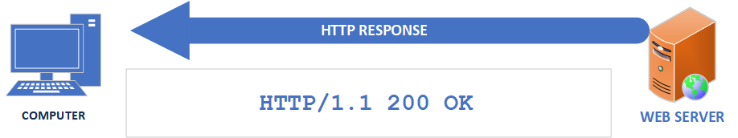
STATIC HTML - Response
When the web server receives the HTTP Request it looks for the requested file in the specified directory
If the file is found a HTTP response is sent. It begins with the HTTP version, then the response code (200 if the file is found) and a short message explaining the code. Which in this case would be “OK” and ends with the contents of the file in the HTTP Response body. All of this is in plain text.
If the file isn’t found, then an error code is reported. Usually, a 404 followed by the message “Not found”.
Receiving the response, the web browser takes the file contents and sends it to the web browser.

Slide 13
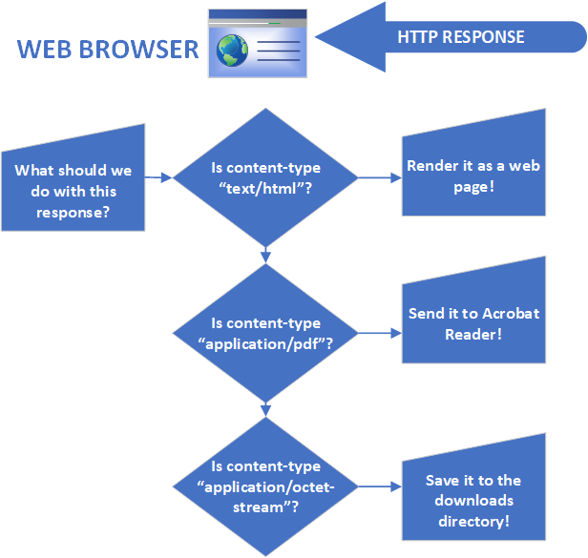
STATIC HTML (legacy)
While it’s up to the web browser to determine what it should do with the data (i.e., is it a web page, a pdf file or an image?) The webserver also sends a hint in one of the headers in the HTTP Response. This is known as the “Content-Type” header.
If the “Content-Type” is “text/html” then the web browser passes it to the part of its program which draws web pages. If it is something else like “image/jpeg” then it passes it to the part of the application which handles that.

Slide 14
STATIC HTML (legacy)
Sometimes the browser needs another application to interpret the data and tells the operating system to open it. Such as “application/pdf” or it may just save the file in a directory. Such as when you download a file.
A user can even instruct the web browser to override the default behaviour to do something else. i.e., Save all PDF files to disk or open all PDF files with Microsoft Word.

Slide 15
HTTP Status Codes
Code | Message | Description
200 | OK | Standard response for a successful request
403 | FORBIDDEN | Server understood the request but is taking no action. This is often results from attempting to access a page that requires a username and password.
404 | NOT FOUND | The requested URL could not be found. Frequently the result of entering a URL which doesn’t point to an actual document.
405 | METHOD NOT ALLOWED | The server is telling you that the HTTP Request method you used is not allowed to access this resource. Frequently this is used by a web application that is trying to force the use of POST instead of GET for submitting form data.
These are just a few of the status codes. There are many more.

Slide 16
HTTP Response
HTTP/1.1 200 OK
Date: Tue, 27 Dec 2020 10:28:53 GMT
Server: Apache/2.2.14 (Win32)
Last-Modified: Mon, 15 Jul 2020 19:15:56 GMT
Content-Length: 88
Content-Type: text/html
Connection: Closed
<!DOCTYPE html>
<html>
<body>
<h1 style="color:green;">Important things!</h1>
<p style="color:purple;">Not-so-important things.</p>
</body>
</html>
The part highlighted in YELLOW is the HTTP HEADER
The part highlighted in GREEN is the HTML DATA

Slide 17
Anatomy of a HTTP Response
HTTP Version
Just like a HTTP Request this will almost always be HTTP/1.1 and will be the only version we deal with in this course.
Status Response Code
In this case the code was “200 OK” which is the standard when the HTTP request is successful. Response codes are always in the format of a three-digit number and then a short text description. There are dozens of possible codes. Some of the more common ones are:
404 Not Found Usually returned when a web server can’t find the document you requested.
401 Unauthorized Frequently used when you request a page from a site that requires a username and password.

Slide 18
Anatomy of a HTTP Response
Date
Date and time the response was sent.
Server
Descripts the web server software that was used and frequently the operating system it is running on.
Last-Modified
The last date the document you requested was modified.
Content-Length
This is the length in bytes of the body of the document. This would be whatever is attached to the body of the response. i.e. HTML

Slide 19
Anatomy of a HTTP Response
Content-Type
This represents the type of media being sent in the body of the Response. Your browser uses this to determine what to do with the data. For example “text/html” means that the browser should interpret the data as HTML. “image/jpeg” causes the browser to interpret the body as an JPEG encoded image.
The browser can also take other actions. An HTTP Response with the Content-Type set to “application/vnd.ms-excel”. Will usually cause a browser to open the document in Microsoft Excel. A Content-Type of “application/octet-stream” will almost always cause the browser to download the file to your computer.
Connection
Indicates what the browser should do with the network connection. Valid options are either “keep-alive” or “close”.

Slide 20
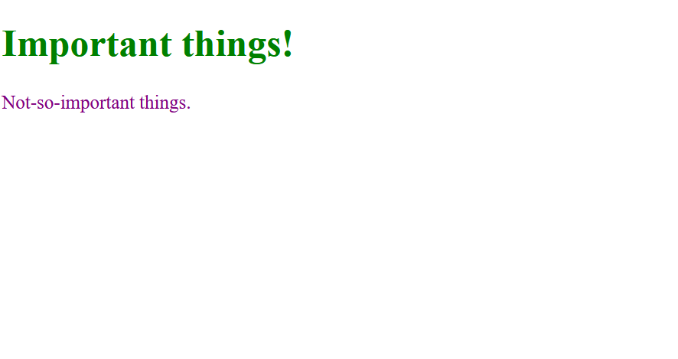
HTML Interpretation
BROWSER OUTPUT
HTML CODE
<!DOCTYPE html>
<html>
<body>
<h1 style="color:green;">
Important things!</h1>
<p style="color:purple;">
Not-so-important things.</p>
</body>
</html>

Slide 21
HTML FORMS
In the original definition for HTML (sometimes called HTML 1.0) documents could only be fetched. Web pages were primarily text and links to other documents.
This all changed when the HTTP 1.0 spec introduced a new Request-method: “POST” which allowed data to be sent to the server. However, how this was to be used was not clear.
In the next specification (HTTP 1.1) a new concept was added. HTML forms, this allowed programmers to create an HTML page that could allow users to enter data into fields and send this data to the web server by clicking a “SUBMIT” button.

Slide 22
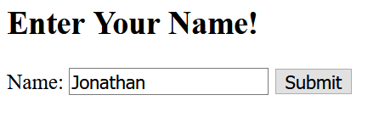
HTML FORMS
HTML form CODE
Resulting form
<!DOCTYPE html>
<html><body>
<h2>Enter Your Name!</h2>
<form action="http://172.16.1.242/webapp">
<label for="name">Name:</label>
<input type="text" id="name" name="name" value="Jonathan">
<input type="submit" value="Submit">
</form></body></html>

Slide 23
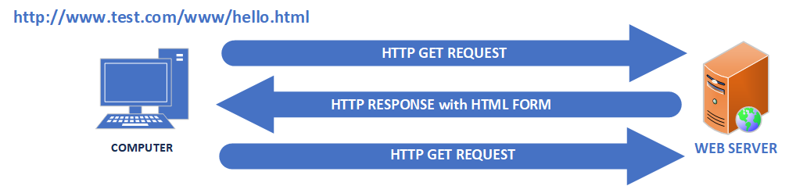
HTML FORMS
404 Not Found
By default, if the users fills out the HTML form and clicks the “submit” button. The browser makes another GET request and sends the data to the web server.
However, if you recall the ONLY information passed from the user to the webserver in the GET method is the path.
So how does the browser send the form data back?

Slide 24
HTTP Request – Form with GET
GET http://172.16.1.242/webapp?name=Jonathan HTTP/1.1
User-Agent: Mozilla/4.0 (compatible; MSIE5.01; Windows NT)
Host: www.test.com
Accept-Language: en-us
Accept-Encoding: gzip, deflate
Connection: Keep-Alive
(there are two <CR><LF> sequences here)
Data entered by the USER
HTTP Request Method
Information supplied by the Browser

Slide 25

HTML FORMS
Sending data in the URL line was fine for sending simple data and great if you wanted it to be cached or bookmarked. However, since it was visible for anyone to see and there was a hard limit on the number of characters (around 2KB). It wasn’t good for sending large amounts of data or sensitive data like passwords.
HTTP 1.0 addressed this with the POST method. POST allows data to be placed into the HTTP Request AFTER the headers. Similar to how a HTTP response returns HTML.
A form can be configured to use POST with the following change to the HTML <form action="http://172.16.1.242/webapp" method="POST">

Slide 26
HTTP Request – Form with POST
POST /webapp HTTP/1.1
Host: 172.16.1.242
Content-Length: 130
Content-Type: multipart/form-data; boundary=----WebKitFormBoundary7MA4YWxkTrZu0gW
<CR><LF>
----WebKitFormBoundary7MA4YWxkTrZu0gW
Content-Disposition: form-data; name="name"
<CR><LF>
Jonathan
----WebKitFormBoundary7MA4YWxkTrZu0gW<CR><LF>
<CR><LF>
Data entered by the USER
HTTP Request Method
Information supplied by the Browser

Slide 27
Anatomy of a HTTP Request
Form Fields:
POST data allows for data of virtually any length or type to be sent to a web server. This creates a problem. A GET Request uses the “&” to separate fields but since a POST could contain an “&” sign. This becomes difficult. The solution is to define a boundary that you are reasonably certain is going to be unique. This gets passed to the server in the Content-Type header as a “boundary”. In this case we are using ----WebKitFormBoundary7MA4YWxkTrZu0gW
Any time the Web Server sees that string. It will assume that data from a form field is contained between it and the next occurrence of the same string.
Content-Disposition
This header indicates to the browser/server how the data should be treated. In a HTTP Response this is almost always used to indicate the name of form-fields by specifying: Content-Disposition: form-data; name="name_of_our_form_field"

Slide 28
WEB ARCHITECTURE (Part I) OVERVIEW
Web applications can be interacted with in several ways. The simplest of which is the fetching of a file from a web server.
The web server replies with an HTTP Response message contains a status code. If the request is accepted this usually contains a status code of “200”. If the file doesn’t exist, the web server could return with a status code of “404”.
In the HTTP Response message, the server sets a field called “response-type” to indicate the kind of data it’s sending you. Depending on the contents of this field the web server might take different actions.
If the browser sees a response-type of “text/html” it is going to assume that the HTTP Response contains HTML which will descript how the web page is supposed to look.

Slide 29
WEB ARCHITECTURE (Part I) OVERVIEW
The HTML could contain a web form which allows data to be sent back to a web application.
The web forms can use either the GET or POST method to send data.
The GET method is good for:
Sending short data that isn’t sensitive.
Sending data that you would like to bookmark or cache.
The POST method is good for:
Data that shouldn’t be cached.
Sending sensitive data.
Sending large amounts of data.

Slide 30
Demonstration

Slide 31
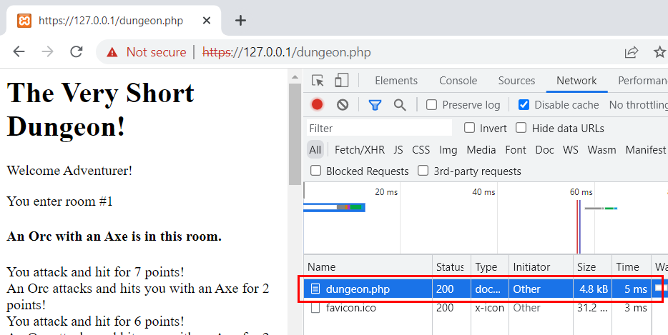
Making GET requests
The simplest way to make a GET request and observe the response it to simply use a web browser. Most modern web browsers have a way to get a detailed look as to what is going on.
On Chrome:
Type <Ctrl>+<Shift>+I to open up the “Developer tools” panel.
Type the address of a simple website in the URL bar. Such as the program dungeon.php file from Lab 2. https://127.0.0.1/dungeon.php
Look at the first entry on the list of HTTP requests. This is the initial HTTP Request made by your browser.

Slide 32
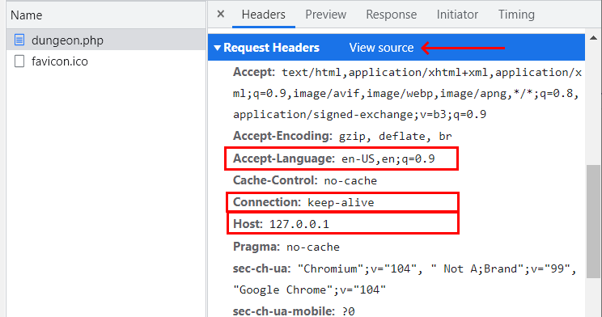
Making GET requests
Clicking on the initial request reveals the ALL the data from the HTTP Request.
Scroll down until you can see the “Request Headers” section.
You should be able to see some headers you recognize. Such as Accept-Language, Connection and Host.
However even this has been formatted a bit to be easier to read. To see the actual data passed. Click “View Source”

Slide 33
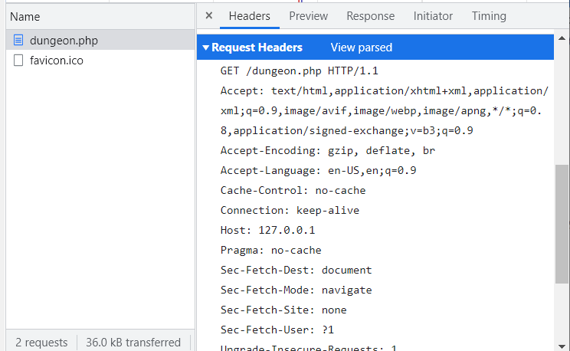
Making GET requests
Now we can see all the data that we sent to the webserver. Including the HTTP Verb and version number.

Slide 34
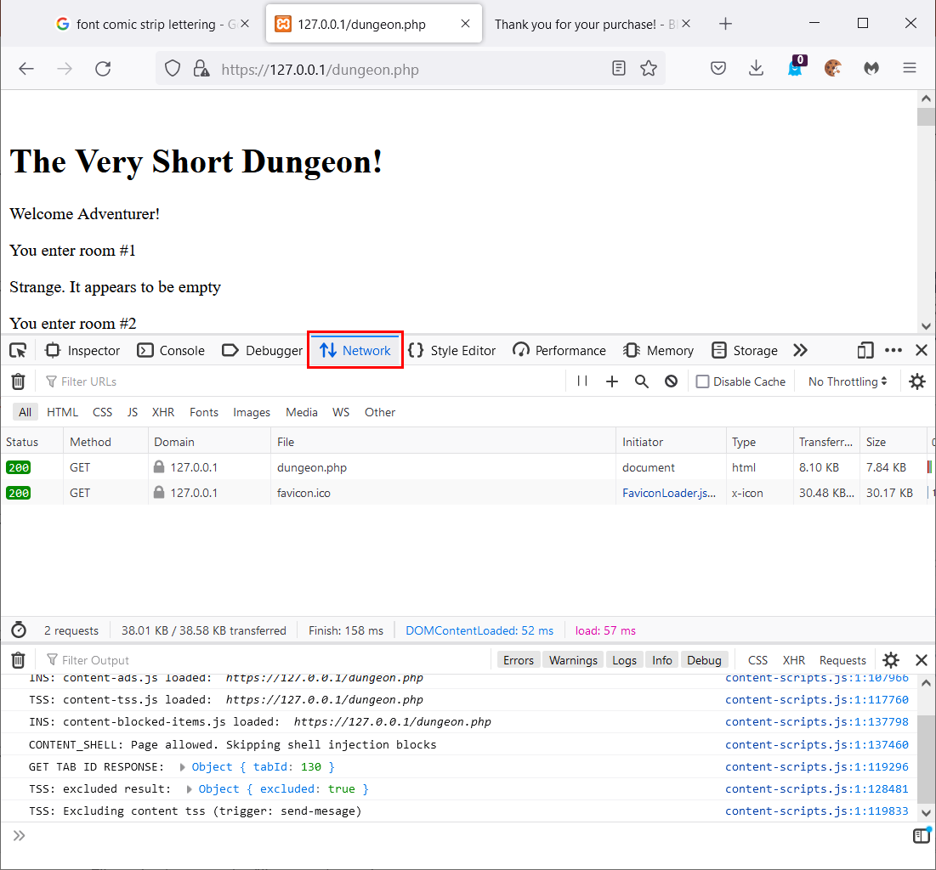
Making GET requests
On Firefox:
Type <Ctrl>+<Shift>+I to open up the “Developer tools” panel.
Click on the tab marked “Network”
Type the address of a simple website in the URL bar. Such as the program dungeon.php file from Lab 2. https://127.0.0.1/dungeon.php
Look at the first entry on the list of HTTP requests. This is the initial HTTP Request made by your browser.

Slide 35
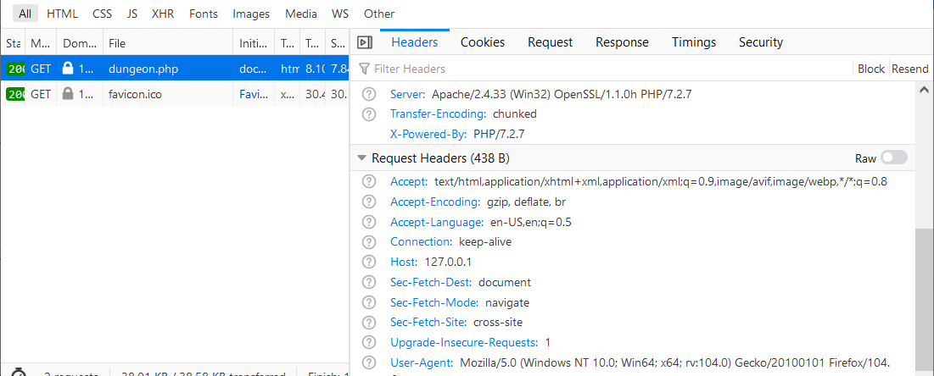
Making GET requests
Clicking on the initial request reveals the ALL the data from the HTTP Request. You may have to scroll down to see it.
Clicking on the switch marked “Raw” will reveal it with as little formatting from the browser as possible.

Slide 36
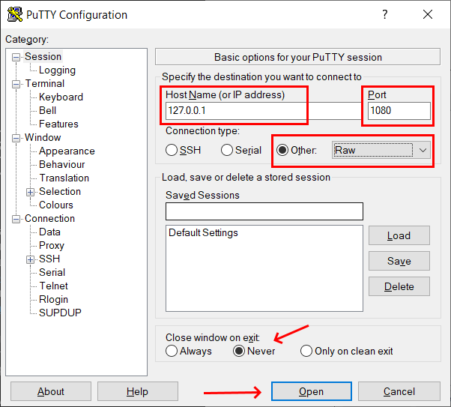
Making GET requests
Another way you can make a GET request is just sending RAW data. You can do this with tool like Putty. Which can be found here: https://www.chiark.greenend.org.uk/~sgtatham/putty/ or downloaded from Mohawk Apps https://apps.mohawkcollege.ca/
Open the application. Set the Host Name to the IP address or DNS name of your website. Which for our local XAMPP server is 127.0.0.1 Do not include the file path.
Set the Port to 1080 (Because the web browser on your local machine is listening on port 80. XAMPP listens on port 1080)
Set the Connection Type to RAW
Set “Close Window on exit” to “Never”
Then click “Open”

Slide 37
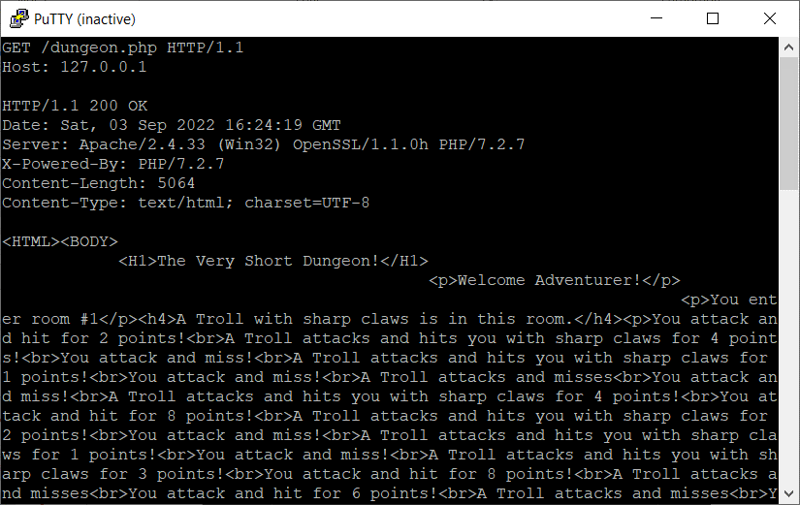
Making GET requests
You will now get a black screen. Your computer is talking to the web server which was listening for a connection on port 1080.
Here you can type in the contents of the HTTP Request manually.

Slide 38
Making GET requests
On the right we’ve typed in a request asking for the document dungeon.php located in the root directory. This is equivalent to typing: https://127.0.0.1/dungeon.php in your web browsers URL bar.
The “Host” header line is required by most web servers in the real world. It should just contain the IP or DNS name of the server you are contacting. Without this the server would just close the connection.
After hitting enter twice (remember there are TWO <CR><LF> at the end of a HTTP Request). We see the HTTP Response including the beginning of the HTML. (The pat that starts <HTML>BODY)

Slide 39

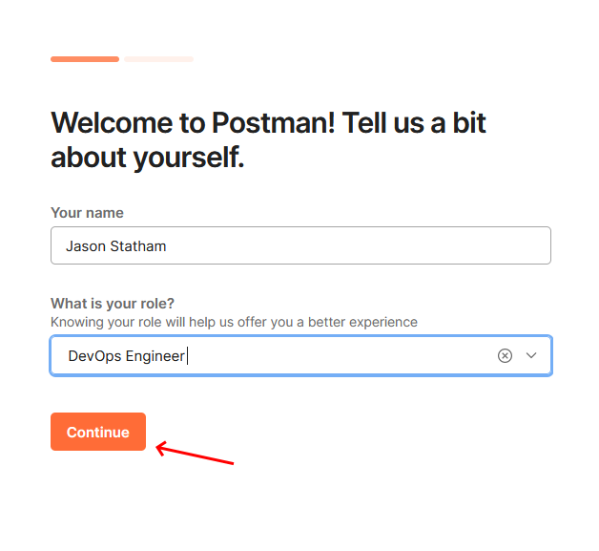
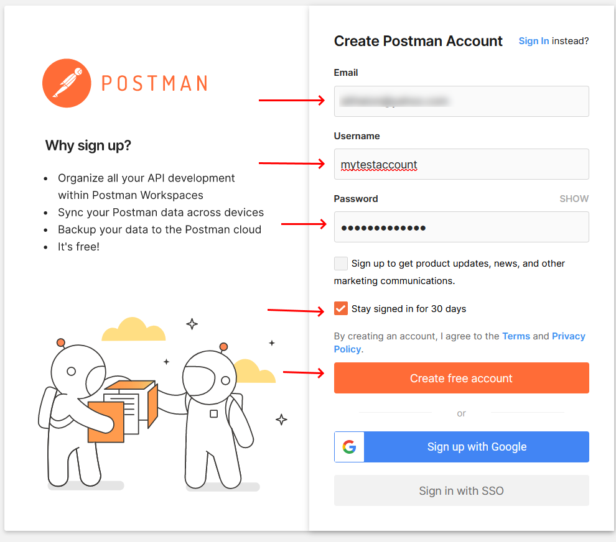

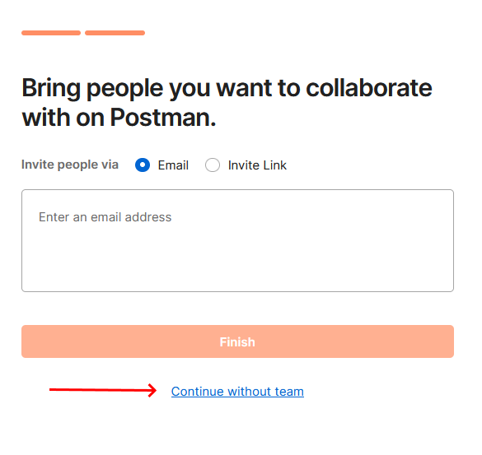


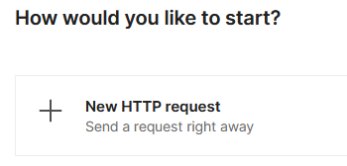
Making POST requests
If you recall a POST request sends its data inside the HTTP Response body rather than as part of the URL. So, as you can imagine it is more complicated to construct.
To create a POST request, we can use a tool like Postman. This is a free-to-use cloud-based application. To do so we will need to create an account:
Start by going here: https://identity.getpostman.com/signup
When asked about your info enter any name/info you want.
When asked about collaboration, select “Continue without Team”
When a menu appears select “New HTTP request”

Slide 40
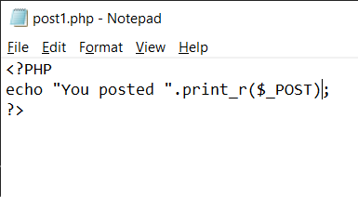
Making POST requests
To finish this, we will need a page that will accept a post request. You can use the code on the right side or make up your own.
The code we see here simply takes everything that is passed into the $_POST array and outputs it in the HTTP Response.
Save this as post1.php in your C:\xampp\htdocs directory.

Slide 41
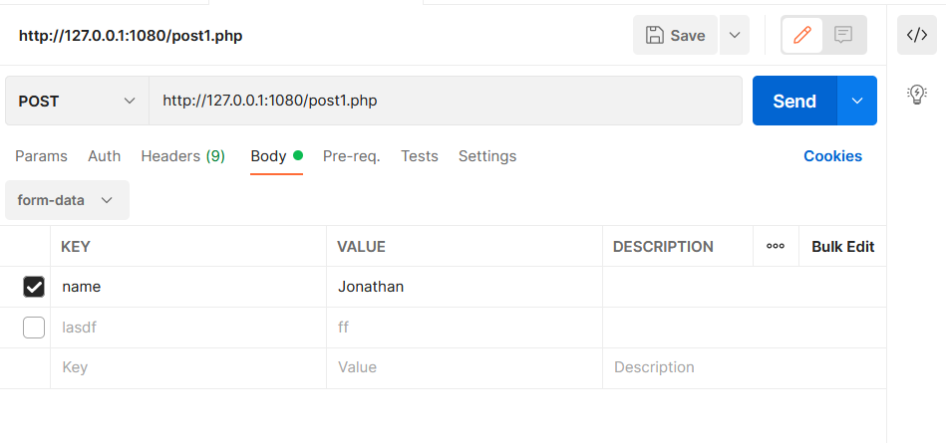

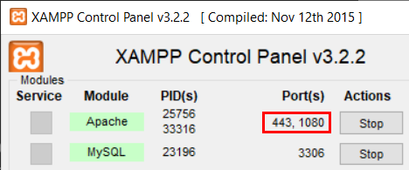
Making POST requests
You should now see a screen with a panel like this on the right-hand side. You can create a post request by doing the following:
Select the HTTP Verb “POST” from the dropdown.
Enter the URL for our application.
Be careful when typing the port number. Your install of XAMPP probably uses a non-standard port. You can check this by going to the XAMPP control panel and looking at the line that says “Apache”.
Here you see that XAMPP is configured for port 443 (which is used by HTTPS) but port 1080 for regular HTTP. If you have installed this on your own equipment this will probably show 80 instead.

Slide 42
Making POST requests
You should now see a screen with a panel like this on the right-hand side. You can create a post request by doing the following:
To specify that we are using a non-standard port add a colon and then the port number after the domain. For example: http://127.0.0.1:1080/post1.php
Select the “Body Tab”
From the dropdown select “form-data”.
Enter one or more keys and values

Slide 43
Making POST requests
You could press “send” at this point, but the request won’t send.
The problem is that the Postman application is being used through your web browser and is sitting on a server on the internet. Which can’t reach our XAMPP server running locally on our machine.
To fix this we need to download the Postman Agent and install it on our machine. You can get it from here: https://www.postman.com/downloads/postman-agent/
Your postman account will keep whatever HTTP requests you are working on from login to login BUT you will need to install the agent on any machine where you want to send a request to a local server.
Once the agent is installed you can click send!

Slide 44
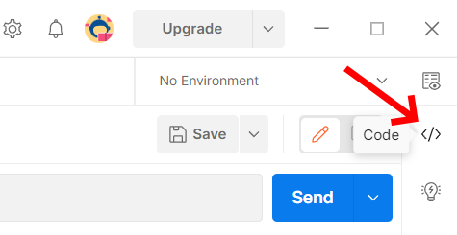
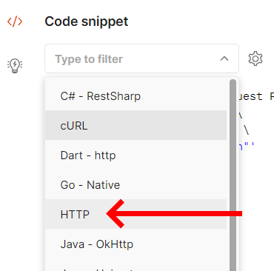
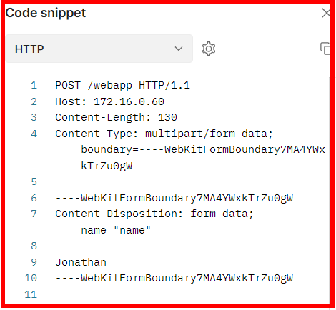
Making POST requests
At the bottom of the screen, we should see the output of our script containing all the data we sent as form variables.
If we want to see how the actual request, we sent looked. We can do the following:
On the top right side o the Postman interface select the </> button.
Click on the drop down with the word “cURL“ and select HTTP.
The end result should look something like the image on the bottom right.

Slide 45
SUMMARY
There are many applications to generate and examine an HTTP Request. The three we will be using in this course are:
Putty
POSTMAN
Chrome/Firefox developer tools
As we move forward in this course, we will be using these tools not just to examine what’s happening behind the scenes, but as we touch on the security of server-side programming, we will learn to use this information to forge or trick applications into working differently than their authors originally intended them to.

